Slide 1
Week3 update

Slide 2
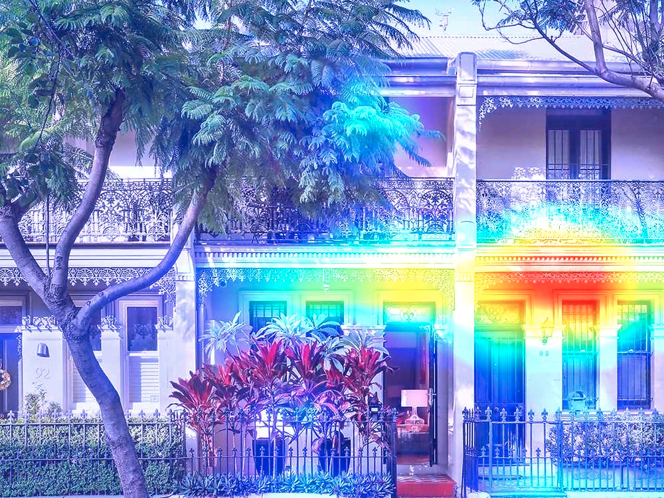
A1
Predicted by Inception v3
41.85% : palace
16.02% : patio
10.27% : picket fence
4.15% : pot
2.01% : flagpole
1.45% : restaurant
1.04% : library
0.94% : window shade
0.88% : monastery
0.67% : sliding door
PREDICTION by VGG16: palace
Class Activation Map

Slide 3
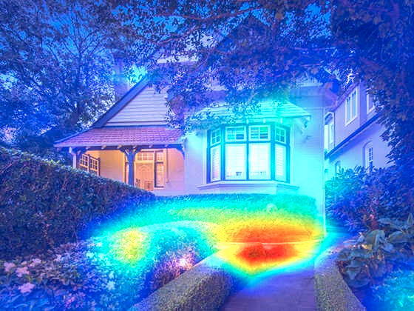
A2
10.87% : patio
9.25% : stone wall
7.59% : greenhouse
5.07% : picket fence
3.72% : thatch
3.40% : castle
3.20% : maze
2.87% : tile roof
2.33% : palace
1.67% : church
PREDICTION: fountain

Slide 4
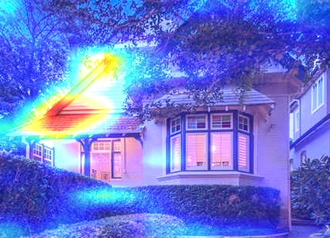
Part of A2
25.85% : church
8.82% : tile roof
8.61% : patio
4.05% : picket fence
3.04% : library
2.18% : palace
1.51% : flagpole
1.40% : thatch
1.36% : window shade
1.33% : monastery
PREDICTION: church

Slide 5
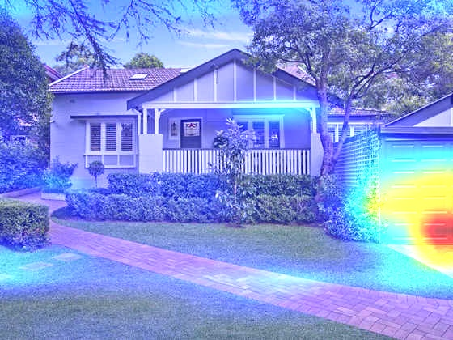
A3
56.45% : mobile home
12.01% : picket fence
4.33% : patio
2.85% : solar dish
1.51% : window screen
1.42% : boathouse
0.78% : worm fence
0.73% : flagpole
0.70% : bannister
0.70% : lakeside
PREDICTION: patio

Slide 6
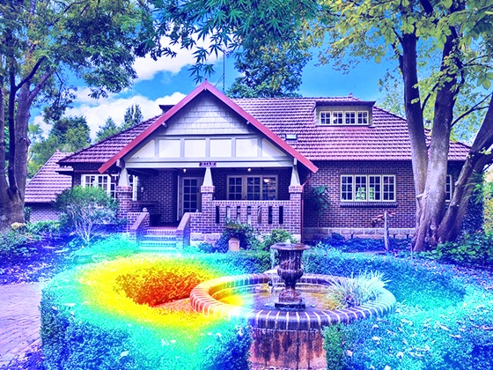
A4
21.64% : maze
15.74% : palace
13.49% : fountain
6.95% : castle
6.50% : patio
5.75% : lakeside
3.21% : monastery
2.33% : tile roof
0.95% : bell cote
0.88% : sundial
PREDICTION: maze

Slide 7
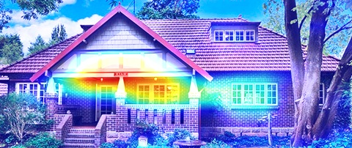
Part of A4
42.59% : patio
9.99% : tile roof
8.23% : picket fence
2.50% : window screen
2.42% : greenhouse
2.05% : lakeside
1.96% : pot
1.46% : thatch
1.35% : church
1.35% : flagpole
PREDICTION: picket_fence

Slide 8
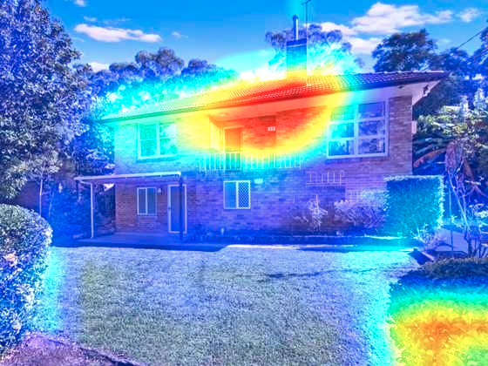
A5
11.81% : tile roof
9.04% : monastery
7.12% : alp
5.77% : patio
4.08% : library
2.89% : lakeside
2.68% : palace
1.76% : solar dish
1.75% : window screen
1.73% : prison
PREDICTION: palace

Slide 9
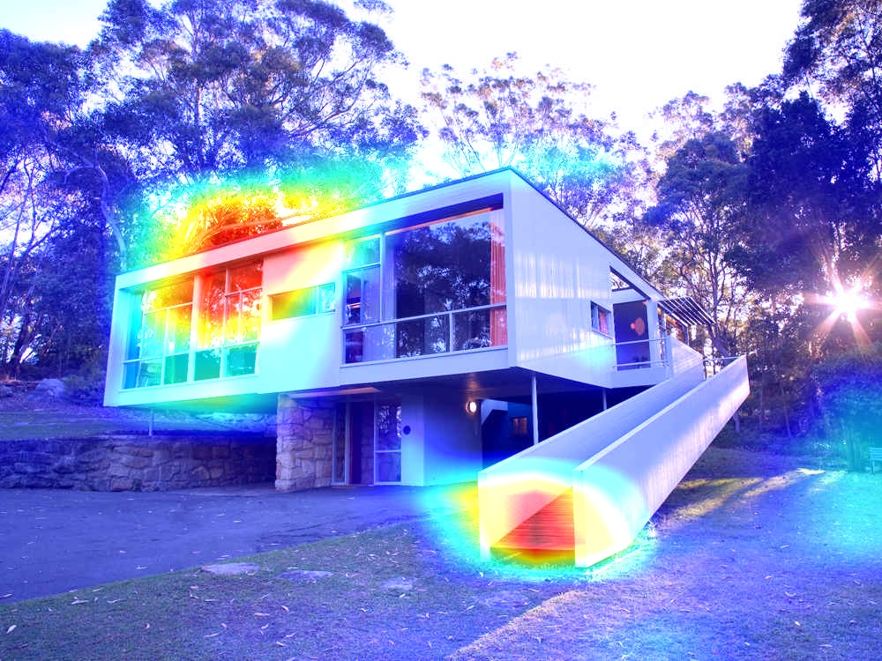
A6
67.21% : mobile home
20.53% : boathouse
0.92% : bannister
0.78% : window screen
0.41% : window shade
0.26% : lakeside
0.24% : paddlewheel
0.17% : greenhouse
0.16% : picket fence
0.15% : patio
PREDICTION: mobile_home

Slide 10
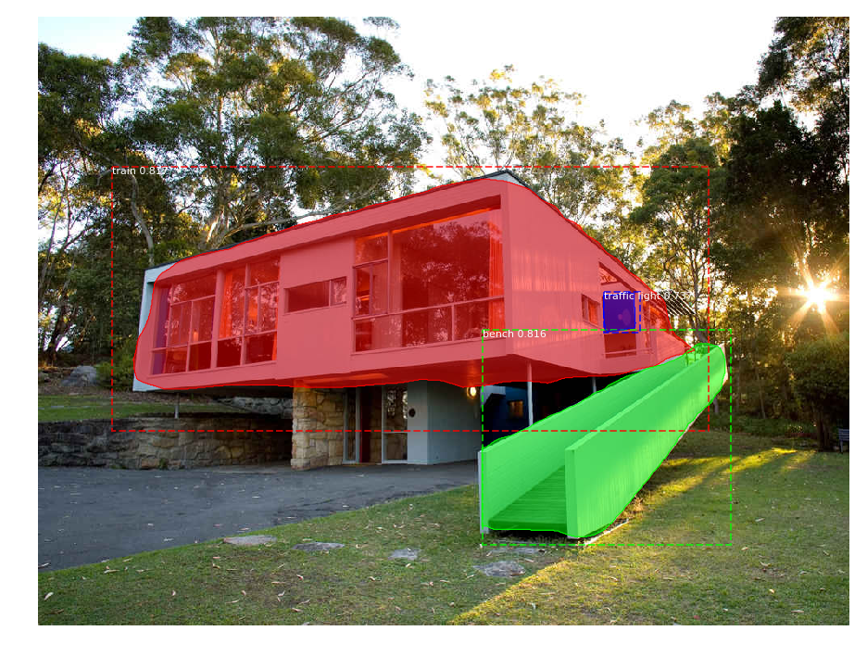
Objects detection on A6

Slide 11
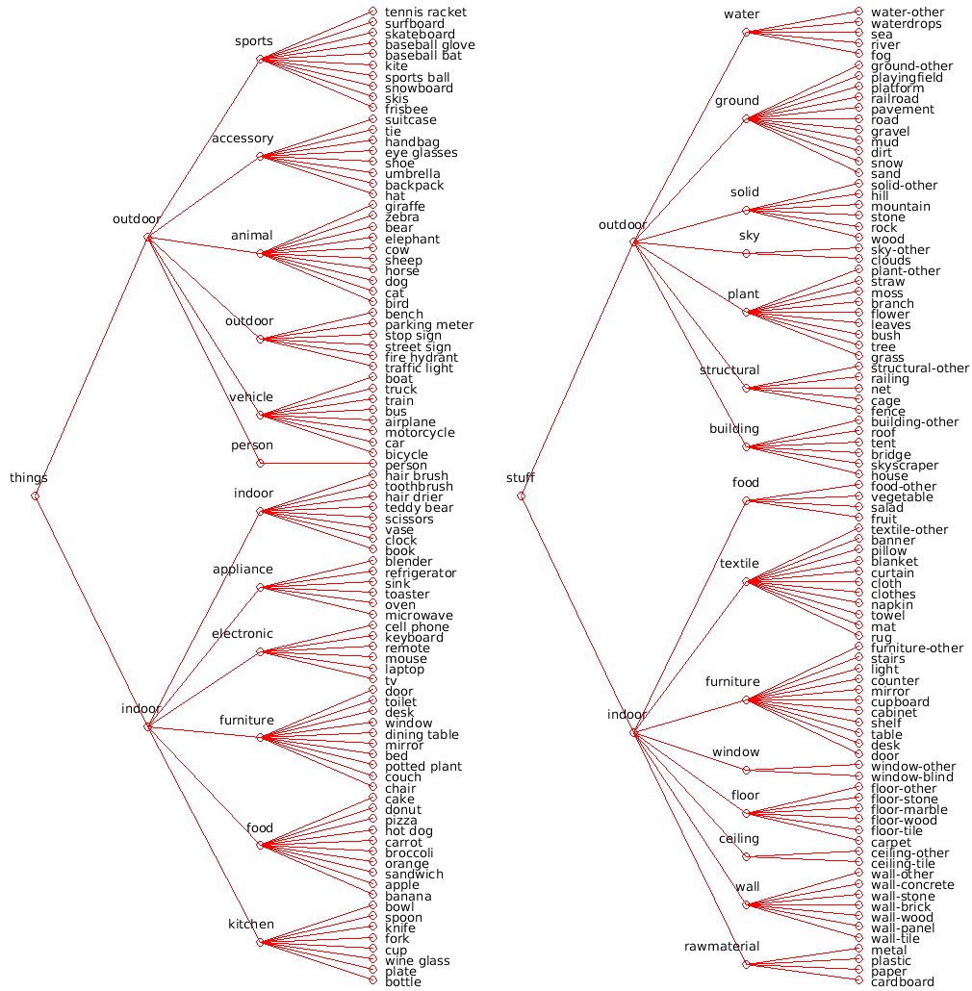
COCO-Stuff
House
Door
Roof
Window

